Slide 1
Small ruminant production and management
By
Aishatu. Y. Girgiri (ass Prof.)

Slide 2
Small ruminant production and management
Introduction
Sheep and goats are cloven – footed animals
They belong to the genus Ovis and Capra Respectively
Domesticated over 8000 years ago in Africa along river Nile
Sheep and goats breeds in Nigeria originated from Western Asia
Estimated population stood at 22.1 and 34.5 million respectively
Greater numbers are found in villages than in urban areas
Mostly reared by small holder farmers i.e men, women and children

Slide 3
Selection for Meat production
Important considerations are rapid growth, multiple birth.
Environmental Adaptability
Good conformation i.e large body size, muscling, sound feet and legs

Slide 4
SELECTION OF BUCKS AND RAMS FOR BREEDING
Most critical decision a breeder has to make
Bucks and rams contribute one-half of the genetics to kids and lambs
Inbreeding can be a problem
Sire selection is directed to improve growth, feed efficiency and carcass quality
Select sires with top performance or records
Avoid selecting bucks and rams with poor libido

Slide 5
Importance of sheep and goats
Provide milk, meat to humans
Augment meat and milk supply from cattle
They provide skin, wool, hair and manure
They serve as farm investment which can easily be converted into cash
Form part of dowry and fulfil certain burial ceremonies
Can be offered to parents as mark of respect

Slide 6
Comparative advantages of sheep and goats over other livestock
Cost of buying is cheaper than that of cattle
Cost of feeding and maintenance is lower when compared to cattle
Land requirement is smaller
Competition for food between humans is reduced compared to poultry and swine.
Outputs can be sold in a day in a local market
More prolific than cattle
Generation interval is less than 2 years about 18 – 21 months
They have multiple births, can increase no; over a short period

Slide 7
Breeds of sheep and goats in Nigeria
Balami
Uda
Yan kasa (Koroji)
West African Dwarf (Kirdimi)
Borno white goat or Sahel – varying coat colour, but predominantly white
Maradi or Sokoto red goat – found in Sokoto area and parts of Nigeria
West African dwarf (kirdimi) mostly found in the forest zone of Northern Nigeria

Slide 8
Management systems in sheep and goat production
- Extensive
- Semi-Intensive
- Intensive

Slide 9
Small Ruminant Production Types and Systems In Tropical Africa
Pastoralist
Agropastoralist
Urban
1. traditional
2. Modern
Ranching
Feedlot
Stations
Dairy farms

Slide 10
Feeds and feeding
Feeds is the single most costly item (up to 60% of total cost of production)
Nutrition exerts a very large influence on reproduction and milk production
Late gestation and lactation are the most critical periods of nutrition
Maintenance, pregnancy and lactation affects nutritional requirements
Sheep and goats consume 2 – 4% of their body weight
Environmental conditions i.e cold or severe weather can affect nutritional requirement

Slide 11
Locally available feed ingredient
Millet bran
Maize bran
Sorghum bran
Rice bran
Wheat bran
Soybean milk waste
Cotton seed cake
Sunflower seed meal
Copra meal
Sorrel seed meal
Poultry litter
Tigernut waste
Dusa
Dried food leftover

Slide 12
Classification feed ingredient
S/No | Crop Residues | Agro-Industrial By-Products | Browses
1 | Cowpea husk | Maize bran | Faidherbia albida
2 | Cowpea haulms | Soybean milk residue | Ziziphus Mauritania
3 | Groundnut haulms | Cotton seed cake
4 | Sorghum stover | Wheat offal

Slide 13
Formulate diet for small ruminant
Feed ingredients | T1
Cowpea husk | 20
Groundnut haulms | 20
Wheat offal | 30
Cottonseed cake | 25
Total mixed ratio
SH:CH:WO:CSC
30 : 15 : 30: 20

Slide 14
Hydroponic
Hydroponic fodder production technology is growing of fodder without soil but in water for a maximum of 7-10 days.
Grains such as barley are grown in a hygienic environment free of chemicals, and artificial growth promoters.
Hydroponically fodder requires a small piece of land for production and has high feed quality that is rich with proteins, fibers, vitamins, and minerals with health beneficial effects on animals.
The technology is simple requiring minimal effort to achieve the desired goal. Before embarking on hydroponic fodder production, one should prepare the site, net it and should be close to water source. followings:

Slide 15
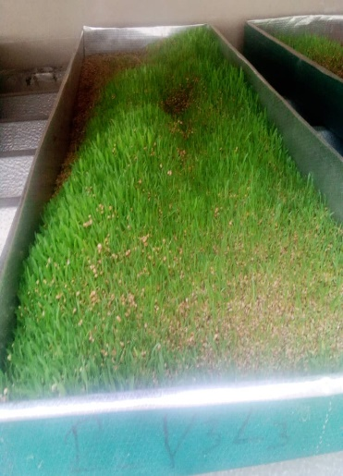
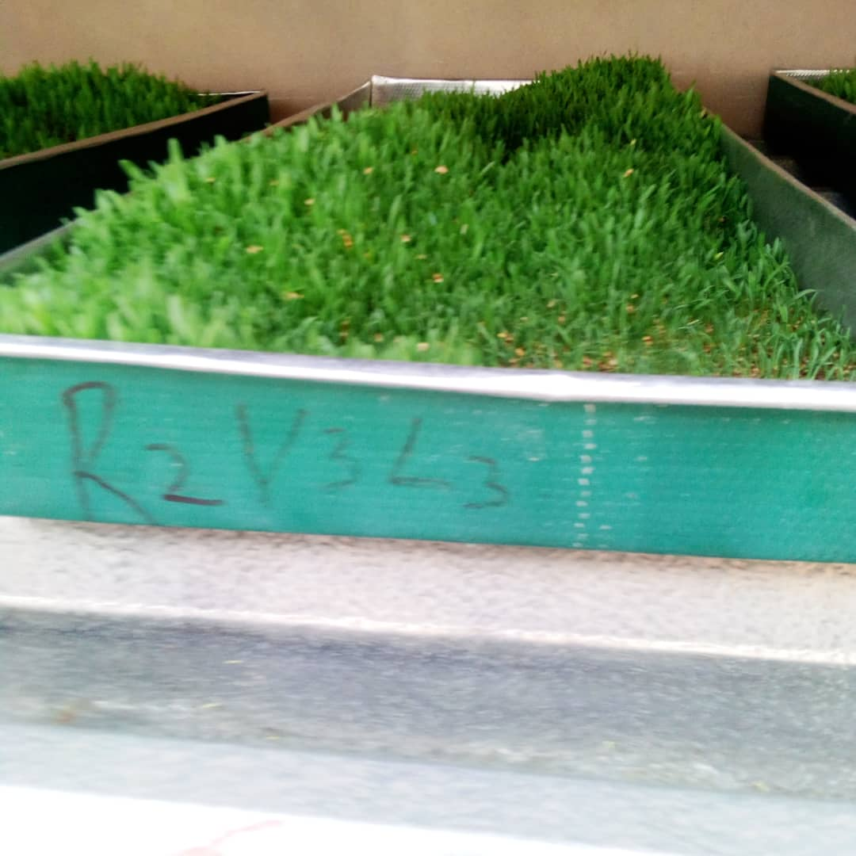
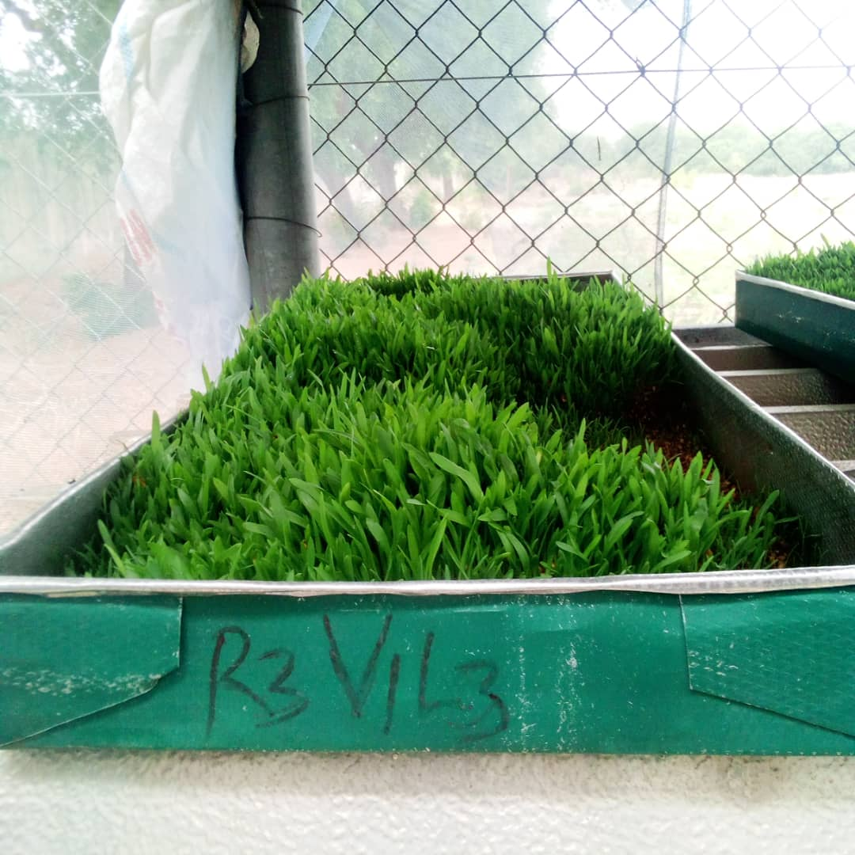
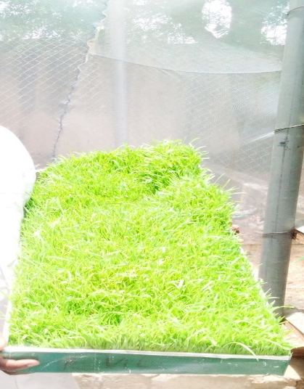
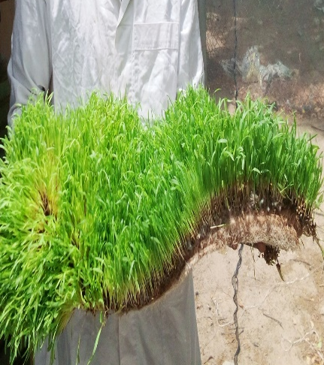
Day 4 | Day 5 | Day 6
Day 7 | Day 8 | Harvested fodder (mat)

Slide 16
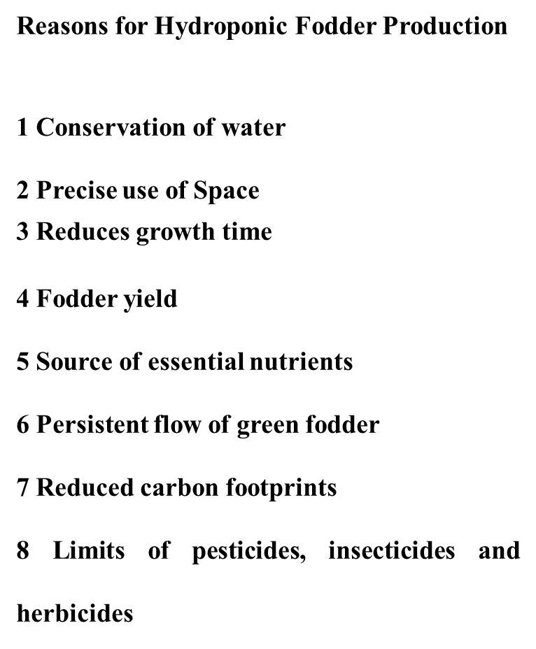

Slide 17
Marketing of sheep and goats
Involves series of activities
Transfer of farm animals and their products
Selling and buying

Slide 18
Marketing channels
Sheep/ goat owner
Individual buyer, butcher
Market
Wholesale buying agent
Wholesale buyer
Wholesale/selling agent

Slide 19
Thanks for listening

